Slide 1
IPv4 ADDRESSES
An IPv4 address is a 32-bit address that uniquely and universally defines the connection of a device (for example, a computer or a router) to the Internet.
Topics discussed in this section:
Address Space
Notations
Classful Addressing
Classless Addressing
Network Address Translation (NAT)

Slide 2

Note
An IPv4 address is 32 bits long.

Slide 3
Note
The IPv4 addresses are unique
and universal.
19.<number>

Slide 4
Note
The address space of IPv4 is
2³² or 4,294,967,296.
19.<number>

Slide 5

Figure 19.1 Dotted-decimal notation and binary notation for an IPv4 address
19.<number>

Slide 6


Example 19.1
Change the following IPv4 addresses from binary notation to dotted-decimal notation.
Solution
We replace each group of 8 bits with its equivalent decimal number (see Appendix B) and add dots for separation.
19.<number>

Slide 7
Example 19.2
Change the following IPv4 addresses from dotted-decimal notation to binary notation.
Solution
We replace each decimal number with its binary equivalent (see Appendix B).
19.<number>

Slide 8
Note
In classful addressing, the address space is divided into five classes:
A, B, C, D, and E.
19.<number>

Slide 9

Figure 19.2 Finding the classes in binary and dotted-decimal notation
19.<number>

Slide 10
Example 19.4
Find the class of each address.
a. 00000001 00001011 00001011 11101111
b. 11000001 10000011 00011011 11111111
c. 14.23.120.8
d. 252.5.15.111
Solution
a. The first bit is 0. This is a class A address.
b. The first 2 bits are 1; the third bit is 0. This is a class C
address.
c. The first byte is 14; the class is A.
d. The first byte is 252; the class is E.
19.<number>

Slide 11

Table 19.1 Number of blocks and block size in classful IPv4 addressing
19.<number>

Slide 12
Note
In classful addressing, a large part of the available addresses were wasted.
19.<number>

Slide 13

Table 19.2 Default masks for classful addressing
19.<number>

Slide 14
Note
Classful addressing, which is almost obsolete, is replaced with classless addressing.
19.<number>

Slide 15
Note
In IPv4 addressing, a block of
addresses can be defined as
x.y.z.t /n
in which x.y.z.t defines one of the addresses and the /n defines the mask.
19.<number>

Slide 16
Note
The first address in the block can be found by setting the rightmost
32 − n bits to 0s.
19.<number>

Slide 17
Example 19.6
A block of addresses is granted to a small organization. We know that one of the addresses is 205.16.37.39/28. What is the first address in the block?
Solution
The binary representation of the given address is
11001101 00010000 00100101 00100111
If we set 32−28 rightmost bits to 0, we get
11001101 00010000 00100101 0010000
or
205.16.37.32.
This is actually the block shown in Figure 19.3.
19.<number>

Slide 18
Note
The last address in the block can be found by setting the rightmost
32 − n bits to 1s.
19.<number>

Slide 19
Example 19.7
Find the last address for the block in Example 19.6.
Solution
The binary representation of the given address is
11001101 00010000 00100101 00100111
If we set 32 − 28 rightmost bits to 1, we get
11001101 00010000 00100101 00101111
or
205.16.37.47
This is actually the block shown in Figure 19.3.
19.<number>

Slide 20
Note
The number of addresses in the block can be found by using the formula
2^{32−n}.
19.<number>

Slide 21
Example 19.8
Find the number of addresses in Example 19.6.
Solution
The value of n is 28, which means that number
of addresses is 2 ³²⁻²⁸ or 16.
19.<number>

Slide 22
Example 19.9
Another way to find the first address, the last address, and the number of addresses is to represent the mask as a 32-bit binary (or 8-digit hexadecimal) number. This is particularly useful when we are writing a program to find these pieces of information. In Example 19.5 the /28 can be represented as
11111111 11111111 11111111 11110000
(twenty-eight 1s and four 0s).
Find
a. The first address
b. The last address
c. The number of addresses.
19.<number>

Slide 23

Example 19.9 (continued)
Solution
a. The first address can be found by ANDing the given
addresses with the mask. ANDing here is done bit by
bit. The result of ANDing 2 bits is 1 if both bits are 1s;
the result is 0 otherwise.
19.<number>

Slide 24

Example 19.9 (continued)
b. The last address can be found by ORing the given
addresses with the complement of the mask. ORing
here is done bit by bit. The result of ORing 2 bits is 0 if
both bits are 0s; the result is 1 otherwise. The
complement of a number is found by changing each 1
to 0 and each 0 to 1.
19.<number>

Slide 25

Figure 19.4 A network configuration for the block 205.16.37.32/28
19.<number>

Slide 26
Note
The first address in a block is
normally not assigned to any device;
it is used as the network address that represents the organization
to the rest of the world.
19.<number>

Slide 27

Figure 19.6 A frame in a character-oriented protocol
19.<number>

Slide 28
Note
Each address in the block can be considered as a two-level
hierarchical structure:
the leftmost n bits (prefix) define
the network;
the rightmost 32 − n bits define
the host.
19.<number>

Slide 29

Figure 19.7 Configuration and addresses in a subnetted network
19.<number>

Slide 30

Figure 19.8 Three-level hierarchy in an IPv4 address
19.<number>

Slide 31
Example 19.10
An ISP is granted a block of addresses starting with 190.100.0.0/16 (65,536 addresses). The ISP needs to distribute these addresses to three groups of customers as follows:
a. The first group has 64 customers; each needs 256
addresses.
b. The second group has 128 customers; each needs 128
addresses.
c. The third group has 128 customers; each needs 64
addresses.
Design the subblocks and find out how many addresses are still available after these allocations.
19.<number>

Slide 32
Example 19.10 (continued)
Solution
Figure 19.9 shows the situation.
Group 1
For this group, each customer needs 256 addresses. This means that 8 (log2 256) bits are needed to define each host. The prefix length is then 32 − 8 = 24. The addresses are
19.<number>

Slide 33

Example 19.10 (continued)
Group 2
For this group, each customer needs 128 addresses. This means that 7 (log2 128) bits are needed to define each host. The prefix length is then 32 − 7 = 25. The addresses are
19.<number>

Slide 34

Example 19.10 (continued)
Group 3
For this group, each customer needs 64 addresses. This means that 6 (log₂64) bits are needed to each host. The prefix length is then 32 − 6 = 26. The addresses are
Number of granted addresses to the ISP: 65,536
Number of allocated addresses by the ISP: 40,960
Number of available addresses: 24,576
19.<number>

Slide 35

Figure 19.10 A NAT implementation
19.<number>

Slide 36

Figure 19.11 Addresses in a NAT
19.<number>

Slide 37

Figure 19.12 NAT address translation
19.<number>

Slide 38

Table 19.4 Five-column translation table
19.<number>

Slide 39
19-2 IPv6 ADDRESSES
Despite all short-term solutions, address depletion is still a long-term problem for the Internet. This and other problems in the IP protocol itself have been the motivation for IPv6.
Topics discussed in this section:
Structure
Address Space
19.<number>

Slide 40
Note
An IPv6 address is 128 bits long.
19.<number>

Slide 41

Figure 19.14 IPv6 address in binary and hexadecimal colon notation
19.<number>

Slide 42

Figure 19.15 Abbreviated IPv6 addresses
19.<number>

Slide 43

Example 19.11
Expand the address 0:15::1:12:1213 to its original.
Solution
We first need to align the left side of the double colon to the left of the original pattern and the right side of the double colon to the right of the original pattern to find how many 0s we need to replace the double colon.
This means that the original address is.
19.<number>

Slide 44
IPv4 Addressing Concepts and Their IPv6 Equivalents
IPv4 Address | IPv6 Address
Address Length – 32 bits | 128 bits
Address Representation - decimal | hexadecimal
Internet address classes | Not applicable in IPv6
Multicast addresses (224.0.0.0/4) | IPv6 multicast addresses (FF00::/8)
Broadcast addresses | Not applicable in IPv6
Unspecified address is 0.0.0.0 | Unspecified address is ::
Loopback address is 127.0.0.1 | Loopback address is ::1
Public IP addresses | Global unicast addresses
Private IP addresses (10.0.0.0/8, 172.16.0.0/12, and 192.168.0.0/16) | Site-local addresses (FEC0::/10)
Autoconfigured addresses (169.254.0.0/16) | Link-local addresses (FE80::/64)
IPv6 Packet Format

Slide 45
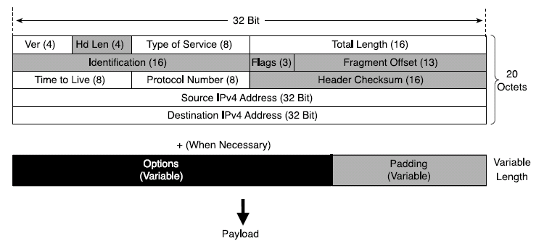
IPv4 Header Structure
basic IPv4 header contains 12 fields.
each field of the IPv4 header has a specific use.
Shaded field are removed in IPv6.
Notes:
Version (4 bits)--Represents the version of the IP protocol. In this case, the field is set to 4.
Header Length (4 bits)--The length in octets of the packet header.
Type of Service (ToS) (8 bits)--This field carries information that enables routers to classify and forward packet in a differentiated manner. It is an important service identifier used in implementing quality of service (QoS).
Total Length (16 bits)The length in octets of the entire packet, header plus payload. With 16 bits available in this field, the maximum length of an IPv4 packet is 65,535 octets.
Identification (16 bits), Flags (3 bits), Fragment Offset (13 bits)--These three fields enable IPv4 networks to support packet fragmentation to negotiate forwarding over links supporting various maximum transmission units (MTUs). Fragmentation is done as needed by the routers along the path of the packet.
Time To Live (8 bits)--It is important to protect a network's resources from packets that loop due to routing problems. This field is used to count down the number of routers that switched the packet. The packet is discarded when the value of this field is 0.
Protocol Number (8 bits)--The Protocol Number lists the upper- layer protocol (TCP, UDP, ICMP, and so on) that is present in the packet payload. The numbers that represent these protocols are assigned by IANA (http://www.iana.org/assignments/protocol- numbers).
Header Checksum (16 bits)--The integrity of the packet header is verified by comparing the computed checksum with the value listed in this field.
Source IPv4 Address (32 bits)--The IPv4 address of the node that sourced the packet.
Destination IPv4 Address (32 bits)--The IPv4 address of the packet destination node.
Options (variable length)--This field is meant as a placeholder for the information relevant to proper handling of the data carried by the packet, information that is not represented in the other fields of the header. Because of this field, the IPv4 header has a variable length, justifying the need for the Header Length field.
Padding (variable length)--Is used to align the variable-length Options field to the 32-bit boundary.

Slide 46
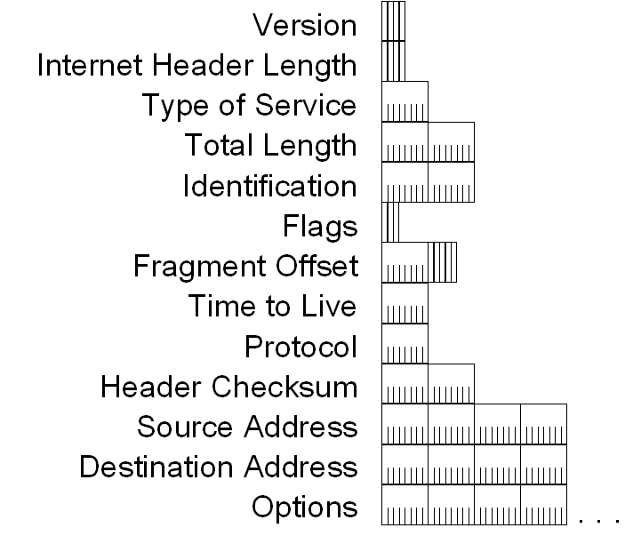
IPv4 Header - Review

Slide 47
IPv4 Header - Review
Version (4 bits)
  Indicates the version of IP and is set to 4.
Internet Header Length (4 bits)
  Indicates the number of 4-byte blocks in the IPv4 header.
  Because an IPv4 header is a minimum of 20 bytes in size, the smallest value of the Internet Header Length (IHL) field is 5.
Type of Service (4 bits)
  Indicates the desired service expected by this packet for delivery through routers across the IPv4 internetwork.
IPv6 Packet Format

Slide 48
IPv4 Header - Review
Total Length (16 bits)
  Indicates the total length of the IPv4 packet (IPv4 header + IPv4 payload) and does not include link layer framing.
Identification (16 bits)
  Identifies this specific IPv4 packet.
  The Identification field is selected by the originating source of the IPv4 packet. If the IPv4 packet is fragmented, all of the fragments retain the Identification field value so that the destination node can group the fragments for reassembly.
Flags (3 bits)
  Identifies flags for the fragmentation process.
  There are two flags—one to indicate whether the IPv4 packet might be fragmented and another to indicate whether more fragments follow the current fragment.
Fragment Offset (13 bits)
  Indicates the position of the fragment relative to the original IPv4 payload.
IPv6 Packet Format

Slide 49
IPv4 Header - Review
Time to Live ( 8 bits)
  Indicate the maximum number of links on which an IPv4 packet can travel before being discarded.
  Originally used as a time count with which an IPv4 router determined the length of time required (in seconds) to forward the IPv4 packet, decrementing the TTL accordingly. When the TTL equals 0,an ICMP Time Expired-TTL Expired in Transit message is sent to the source IPv4 address and the packet is discarded.
Protocol (8 bits)
  Identifies the upper layer protocol.
  For example, TCP uses a Protocol of 6, UDP uses a Protocol of 17, and ICMP uses a Protocol of 1.
  The Protocol field is used to demultiplex an IPv4 packet to the upper layer protocol.
IPv6 Packet Format

Slide 50
IPv4 Header - Review
Header Checksum (16 Bits)
  Provides a checksum on the IPv4 header only.
  The IPv4 payload is not included in the checksum calculation as the IPv4 payload and usually contains its own checksum..
Source Address ( 32 bits)
  Stores the IPv4 address of the originating host.
Destination Address (32 bits)
  Stores the IPv4 address of the destination host.
Options (multiple of 32 bits)
  Stores one or more IPv4 options.
IPv6 Packet Format

Slide 51
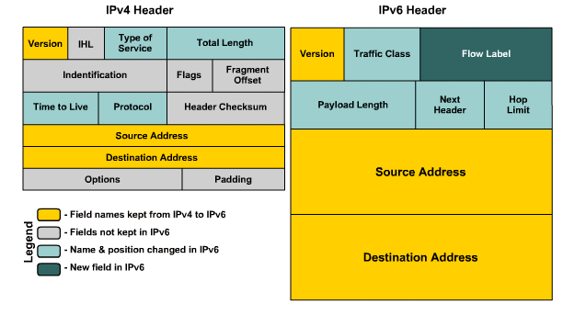
IPv4 vs IPv6 Header
IPv6 Packet Format

Slide 52
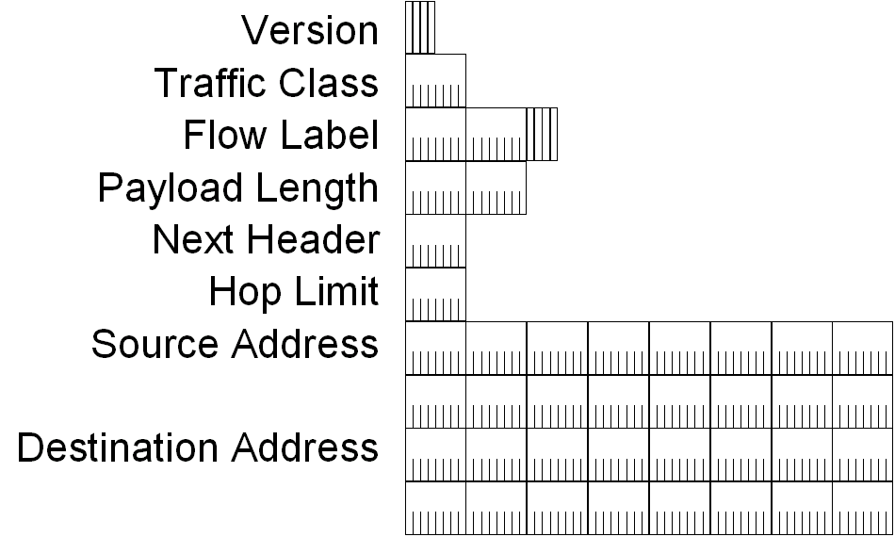
IPv6 Header
IPv6 Packet Format

Slide 53
IPv6 Header Fields
Based on these rules, RFC 2460 defines the following IPv6 header fields:
  Version (4 bits)
    4 bits are used to indicate the version of IP and is set to 6
  Traffic Class (8 bits)
    same function as the Type of Service field in the IPv4 header.
  Flow Label (20 bits)
    identifies a flow and it is intended to enable the router to identify packets that should be treated in a similar way without the need for deep lookups within those packets.
    set by the source and should not be changed by routers along the path to destination.

Slide 54
IPv6 Header Fields
Payload Length (16 bits)
  With the header length fixed at 40 bytes, it is enough to indicate the length of the payload to determine the length of the entire packet.
Next Header (8 bits)
  Indicates either the first extension header (if present) or the protocol in the upper layer PDU (such as TCP, UDP, or ICMPv6).
Hop Limit (8 bits)
  In IPv6, the IPv4 TTL was appropriately renamed Hop Limit because it is a variable that is decremented at each hop, and it does not have a temporal dimension.
IPv6 Packet Format

Slide 55
IPv6 Header Fields
Source IPv6 Address (128 bits)
  Stores the IPv6 address of the originating host.
Destination IPv6 Address (128 bits)
  Stores the IPv6 address of the current destination host.
IPv6 Packet Format

Slide 56
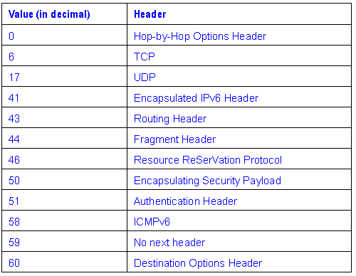
Values of the Next Header Field
IPv6 Packet Format

Slide 57
What is an IP address?
IP (Internet Protocol) address
  device used by routers, to select best path from source to destination, across networks and internetworks
  network layer address, consisting of NETWORK portion, and HOST portion
  logical address,assigned in software by network administrator
  part of a hierarchical ‘numbering scheme’ - unique, for reliable routing
  may be assigned to a host pc, or router port

Slide 58
Types of IP address
Static address
Dynamic address

Slide 59
Types of IP address
Static IP address
  manually input by network administrator
  manageable for small networks
  requires careful checks to avoid duplication

Slide 60
Types of IP address
Dynamic IP address
examples - BOOTP, DHCP
  assigned by server when host boots
  derived automatically from a range of addresses
  duration of ‘lease’ negotiated, then address released back to server

Slide 61
Classes of IP address
Class A - large organizations , governments
Class B - medium sized organizations
Class C - small organizations

Slide 62
Class A IP address
1st octet = network address, octets 2-4 = host address
1st bits of 1st octet set to 0
up to (2^²⁴ - 2) host addresses (16.8M)

Slide 63
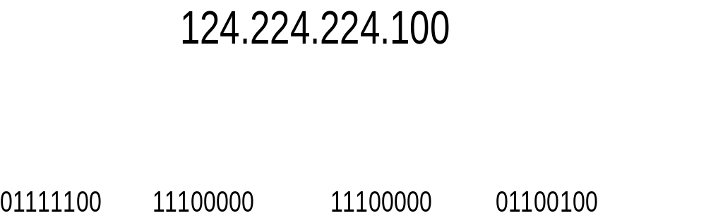
Class A IP address

Slide 64
Class B IP address
1st 2 octets = network address, octets 3-4 = host address
1st 2 bits of 1st octet set to 10
up to (2^¹⁶ - 2) host addresses (65534)

Slide 65
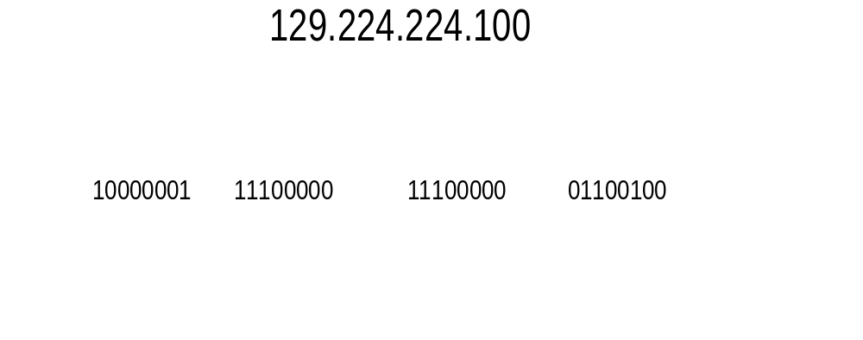
Class B IP address

Slide 66
Class C IP address
1st 3 octets = network address, octet 4 = host address
1st 3 bits of 1st octet set to 110
up to (2^⁸ - 2) host addresses (254)

Slide 67
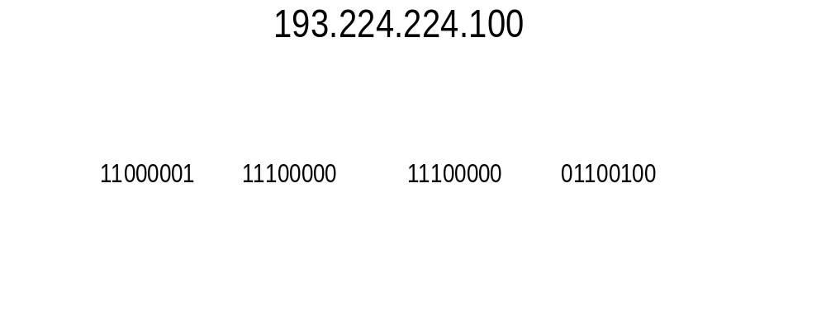
Class C IP address

Slide 68
IP addresses and routing
routing tables
identifying source and destination
IP packet routing

Slide 69
IP addresses and routing -Routing tables
  created by router, held in memory, constantly updated
based on cross-referencing
  IP packet source address, and port on which received

Slide 70
IP addresses and routing Identifying source and destination
  as part of a layer 3 packet, IP header contains source and destination address
  each address is 32 bits long, and unique to device or port
  router reads destination IP address, checks against routing tables

Slide 71
IP addresses and routing - IP packet routing
  if destination address not on the same segment as receive port, router sends packet to correct port for routing to destination
  if destination on same segment as receive port, packet not forwarded

Slide 72
Networks and subnets
why subnet
subnet mask
restrictions on ‘borrowed’ bits

Slide 73
why subnet
  reduce broadcast domain, improve network efficiency

Slide 74
subnet masks
  extend NETWORK portion, borrow from HOST portion
  allow external networks to route packets direct to subnet

Slide 75
restrictions on borrowed bits
reserved addresses
  all 0’s= network address, all 1’s broadcast address
minimum of 2 bits borrowed from host portion
minimum of 2 bits left for host portion

Slide 76


Private vs Public IP Addresses
Natting
Whatever connects directly into Internet must have public (globally unique) IP address
There is a shortage of public IPv4 address
So Private IP addresses can be used within a private network
Three address ranges are reserved for private usage
  10.0.0.0/8
  172.16.0.0/16 to 172.31.0.0/16
  192.168.0.0/24 to 192.168.255.0/24
A private IP is mapped to a Public IP, when the machine has to access the Internet

Slide 77
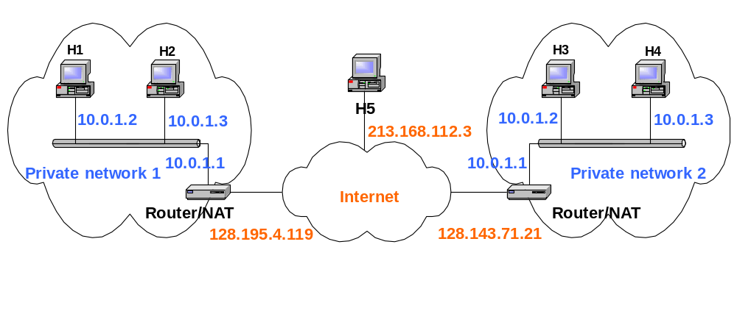
NAT
Natting
NAT (Network Address Translation) Maps Private IPs to Public IPs
It is required because of shortage of IPv4 Address

Slide 78
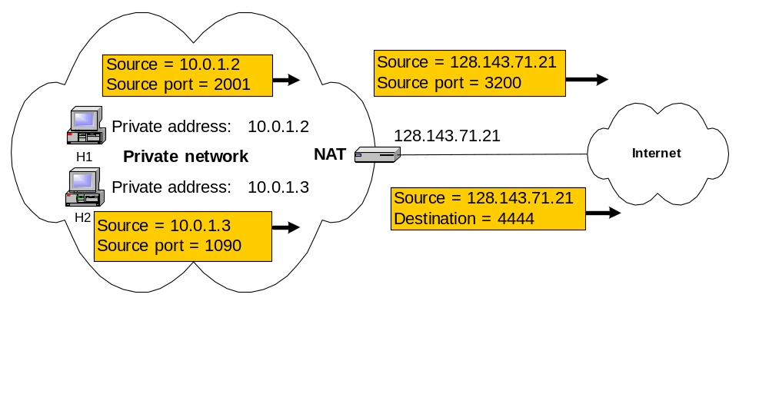
NAT
Natting
Static NAT : Maps unique Private IP to unique Public IP
Dynamic NAT : Maps Multiple Private IP to a Pool of Public IPs (Port Address Translation : Maps a Public IP and Port Number to a service in Private IP)

Slide 79
IP Addressing
IP Subnetting
  Static Subnet
  Variable Length Subnet Masks(VLSMs)

Slide 80
The Hierarchical IP Addressing Scheme
IP address consists of 32 bits of information.
You can depict an IP address using one of three methods:
  Dotted-decimal, as in 172.16.30.56
  Binary, as in 10101100.00010000.00011110.00111000
  Hexadecimal, as in AC.10.1E.38
OIT,RMUTT.

Slide 81
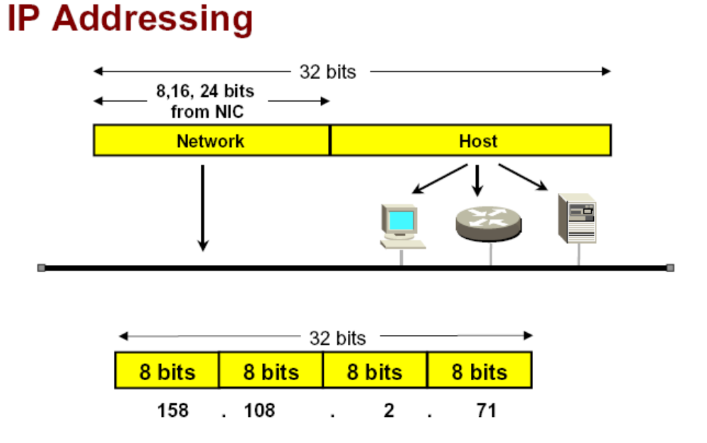
OIT,RMUTT.

Slide 82
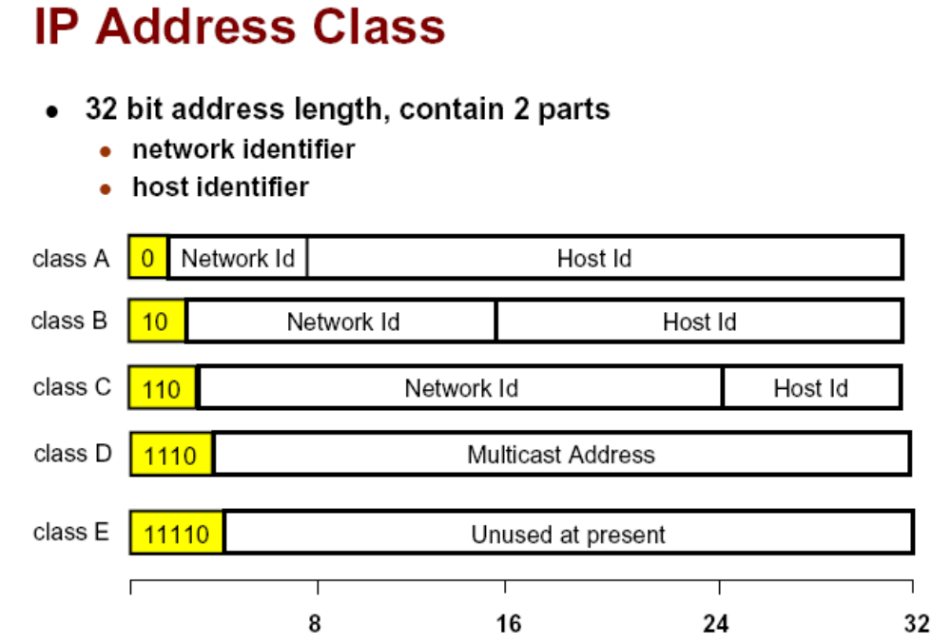
OIT,RMUTT.

Slide 83
Network Addressing
Network Address Range: Class A
  00000000 = 0
  01111111 = 127
Network Address Range: Class B
  10000000 = 128
  10111111 = 191
Network Address Range: Class C
  11000000 = 192
  11011111 = 223
OIT,RMUTT.

Slide 84
Network Address Ranges: Classes D and E
The addresses between 224 and 255 are reserved for Class D and E networks. Class D (224–239) is used for multicast addresses and Class E (240–255) for scientific purposes,
OIT,RMUTT.

Slide 85
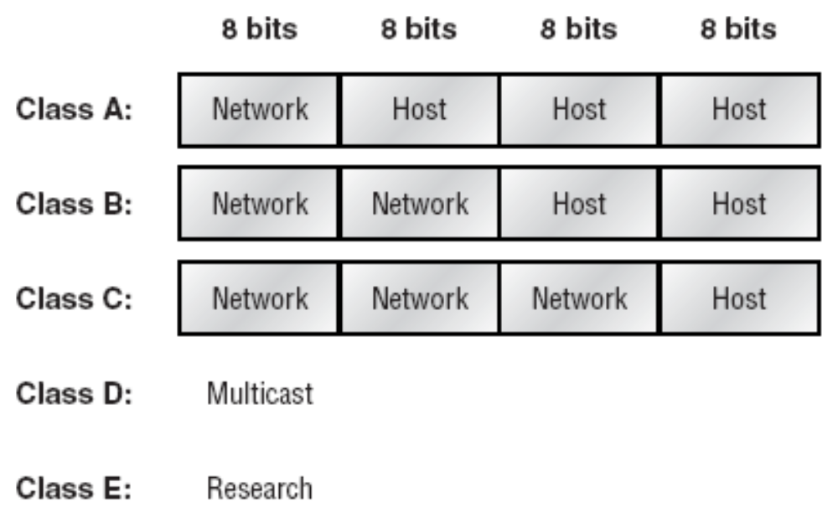
Summary of the three classes of networks
OIT,RMUTT.

Slide 86
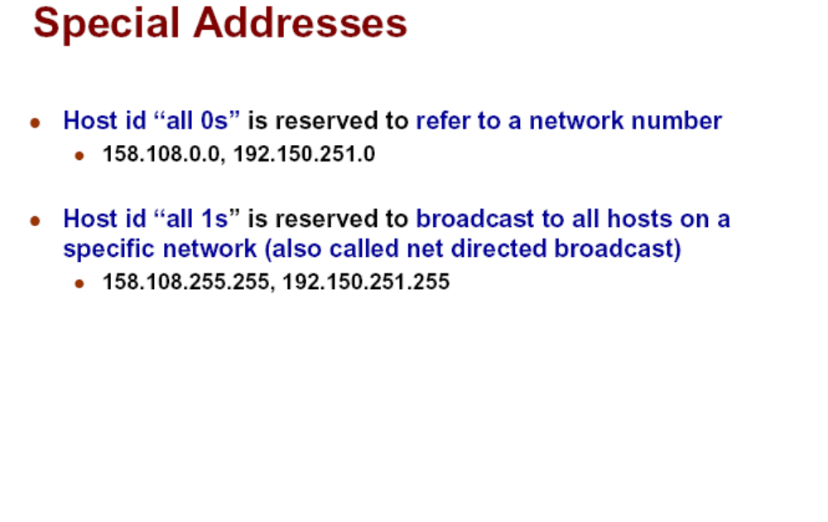
OIT,RMUTT.

Slide 87
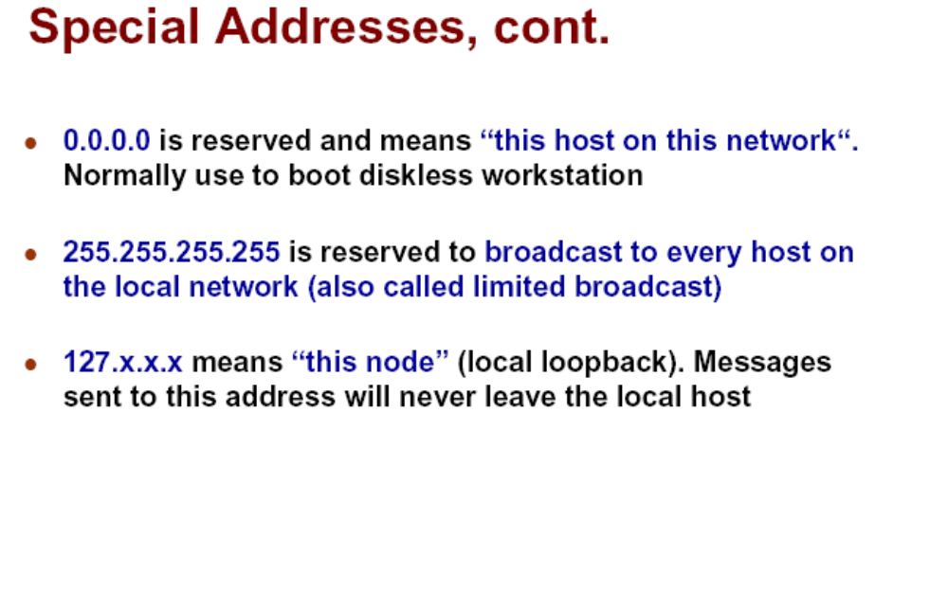
OIT,RMUTT.

Slide 88
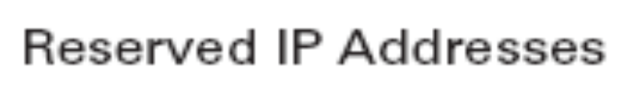
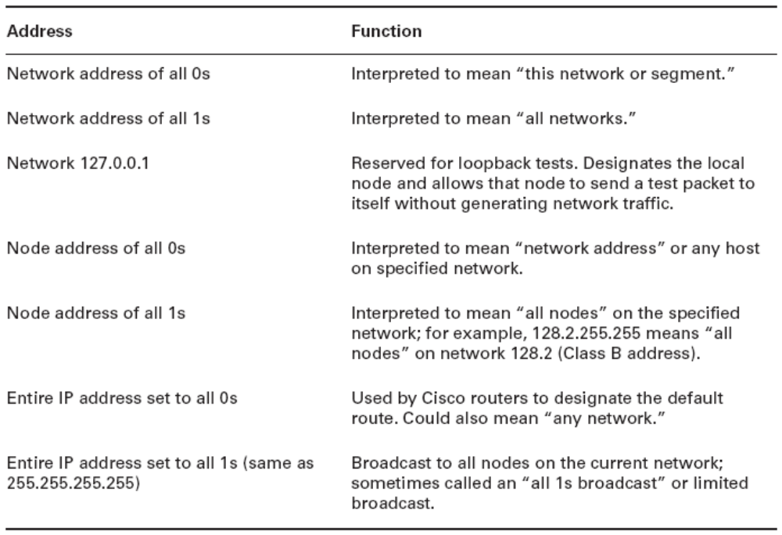
OIT,RMUTT.

Slide 89
Class A Addresses
network.node.node.node
  For example, in the IP address 49.22.102.70, the 49 is the network address, and 22.102.70 is the node address.
  the network address of all 0s (0000 0000) is reserved to designate the default route
  Additionally, the address 127, which is reserved for diagnostics, can’t be used either,
  you can really only use the numbers 1 to 126 to designate Class A network addresses. This
OIT,RMUTT.

Slide 90
Class B Addresses
network.network.node.node
  For example, in the IP address 172.16.30.56, the network address is 172.16, and the node address is 30.56.
OIT,RMUTT.

Slide 91
Class C Addresses
network.network.network.node
  example IP address 192.168.100.102, the network address is 192.168.100, and the node address is 102.
OIT,RMUTT.

Slide 92
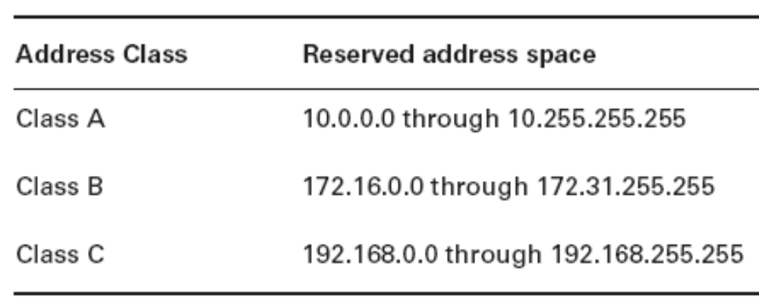
Private IP Addresses
These addresses can be used on a private network, but they’re not routable through the Internet.
OIT,RMUTT.

Slide 93
การแก้ปัญหาข้อจำกัดของ IPv4 Addressing
Network Address Translation
IP Subnetting
OIT,RMUTT.

Slide 94
Introduction to Network Address
Translation (NAT)
In NAT terminology, the inside network is the set of networks that are subject to translation. The outside network refers to all other addresses—usually those located on the Internet.
OIT,RMUTT.

Slide 95
Network Address Translation
There are different flavors of NAT:
  Static NAT Designed to allow one-to-one mapping between local and global addresses.
  Dynamic NAT Designed to map an unregistered IP address to a registered IP address from out of a pool of registered IP addresses.
  Overloading This is the most popular type of NAT configuration. Overloading is a form of dynamic NAT that maps multiple unregistered IP addresses to a single registered IP address (many-to-one) by using different ports.
OIT,RMUTT.

Slide 96
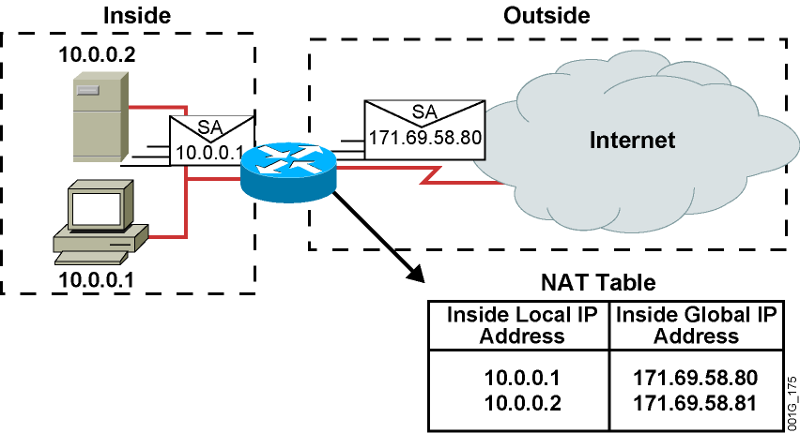
Network Address Translation
An IP address is either local or global.
Local IP addresses are seen in the inside network.
OIT,RMUTT.

Slide 97
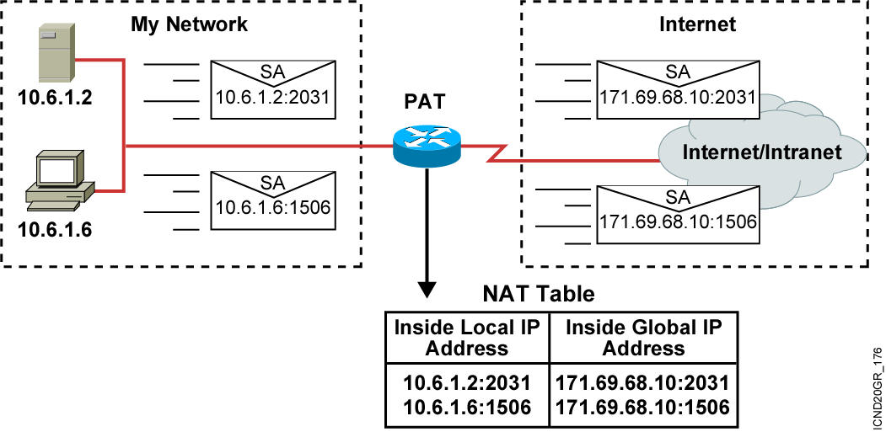
Port Address Translation
OIT,RMUTT.

Slide 98
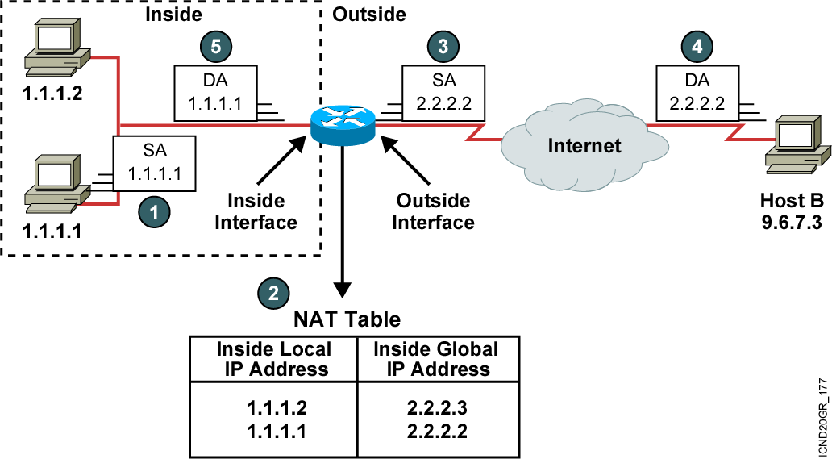
Translating Inside Source Addresses
OIT,RMUTT.

Slide 99
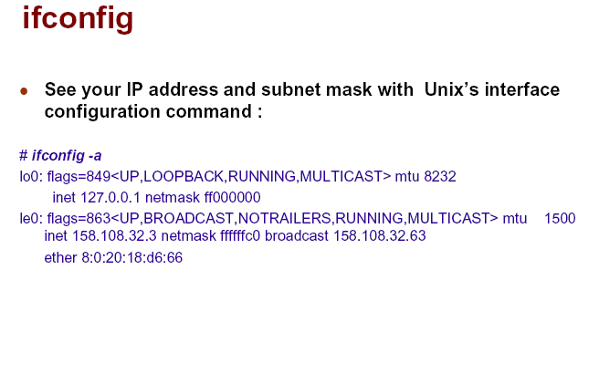
OIT,RMUTT.

Slide 100
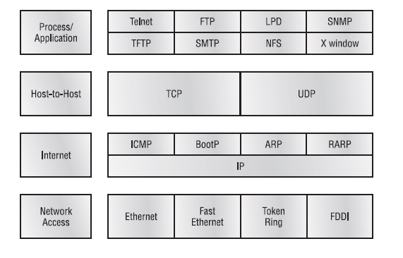
The TCP/IP protocol suite

Slide 101
Telnet – Terminal Emulation allows a user on a remote client machine, called the Telnet client, to access the resources of another machine, the Telnet server.

Slide 102
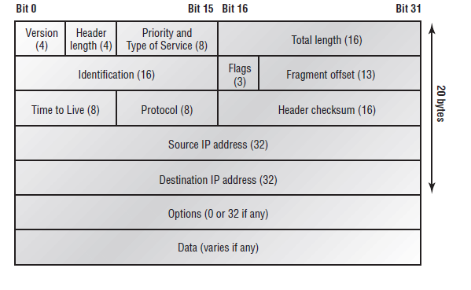
Internet Protocol (IP)

Slide 103
IP Addressing - IP address is a numeric identifier assigned to each machine on an IP network. It designates the location of a device on the network.
An IP address consists of 32 bits of information. These bits are divided into four sections, referred to as octets or bytes, each containing 1 byte (8 bits).
Dotted-decimal, as in 172.16.30.56
Binary, as in 10101100.00010000.00011110.00111000
Hexadecimal, as in 82 39 1E 38 - Windows Registry stores a machine’s IP address in hex.

Slide 104
The 32-bit IP address is a structured or hierarchical address as opposed
to a flat or nonhierarchical, address.
The advantage of this scheme is that it can handle a large number of
Addresses
The disadvantage of this scheme, this would make efficient routing impossible, even if only a fraction of the possible addresses were used.
The solution to this dilemma is to use a two- or three-level, hierarchical
addressing scheme that is structured by network and host, or network, subnet, and host.
This two- or three-level scheme is comparable to a telephone number.
Rather than all 32 bits being treated as a unique identifier, as in flat addressing, a part of the address is designated as the network address, and the other part is designated as either the subnet and host or just the node address.

Slide 105
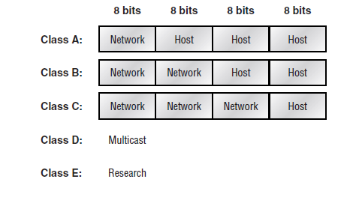
Network Addressing - The network address uniquely identifies each network
The node address is assigned to, and uniquely identifies, each machine on
a network

Slide 106
Class A - 0 and 127
Class B – 128 and 191
Class C- 192 and 223
Class D – 224 and 231
Class E - 232 and 255

Slide 107
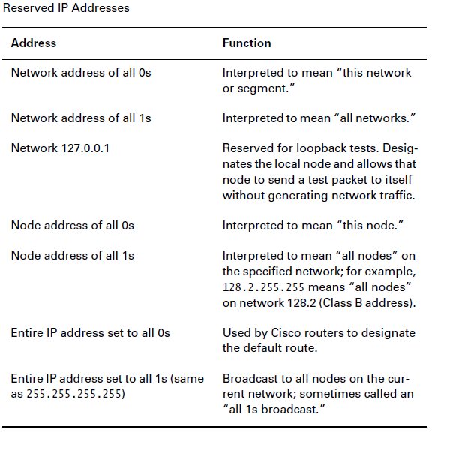

Slide 108
Class A Addresses
Maximum number of Class A networks that can be created is 128 minus 2, or 126
Node address - minus 2, which equals 16,777,214.
Class A Valid Host IDs
10.0.0.0 All host bits off is the network address.
10.255.255.255 All host bits on is the broadcast address.

Slide 109
Class B Addresses
With a network address being two bytes (eight bits each), there would be 216 unique combinations. But the Internet designers decided that all Class B network addresses should start with the binary digit 1, then 0. This leaves 14 bit positions to manipulate, therefore 16,384 (214) unique Class B network addresses.
A Class B address uses two bytes for node addresses. This is 216 minus the two reserved patterns (all 0s and all 1s), for a total of 65,534 possible node addresses for each Class B network.
Class B Valid Host IDs
172.16.0.0 All host bits turned off is the network address.
172.16.255.255 All host bits turned on is the broadcast address.

Slide 110
Class C Addresses
In a Class C network address, the first three bit positions are always the binary 110. The calculation is such: 3 bytes, or 24 bits, minus 3 reserved positions, leaves 21 positions. Hence, there are 221, or 2,097,152, possible Class C networks.
Each unique Class C network has one byte to use for node addresses. This leads to 28 or 256, minus the two reserved patterns of all 0s and all 1s, for a total of 254 node addresses for each Class C network.
Class C Valid Host IDs
192.168.100.0 All host bits turned off is the network ID.
192.168.100.255 All host bits turned on is the broadcast address.

Slide 111
Subnetting
Subnetting - which allows you to take one larger network and break it into many smaller networks.
Reduced network traffic
Optimized network performance
Simplified management
Facilitated spanning of large geographical distances
Subnet Masks
Every machine on the network must know which part of the host address will be used as the subnet address

Slide 112
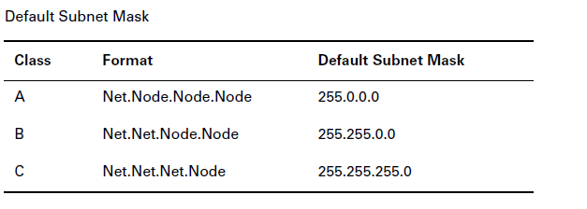

Slide 113
Subnetting Class C Addresses
The Binary Method: Subnetting a Class C Address
The first subnet mask available with a Class C address, which borrows two bits from subnetting. For this example, we are using 255.255.255.192.
192=11000000 Two bits for subnetting, 6 bits for defining the hosts in
each subnet. What are the subnets?
01000000=64 (all host bits off)
or
10000000=128 (all host bits off)

Slide 114
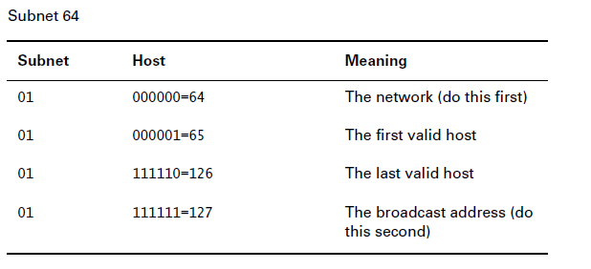
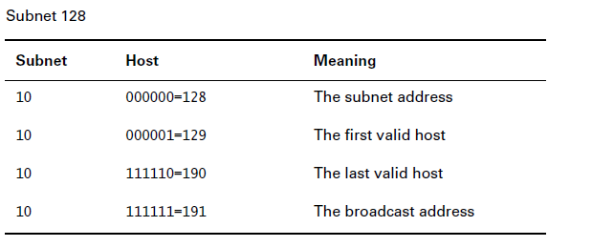

Slide 115
The Alternate Method: Subnetting a Class C Address
1. How many subnets does the subnet mask produce?
2. How many valid hosts per subnet?
3. What are the valid subnets?
4. What are the valid hosts in each subnet?
5. What is the broadcast address of each subnet?
Here is how you determine the answers to the five questions:
1. How many subnets? 2x–2=amount of subnets. X is the amount of masked bits, or the 1s. For example, 11000000 is 22–2. In this example, there are 2 subnets.
2. How many hosts per subnet? 2x–2=amount of hosts per subnet. X is the amount of unmasked bits, or the 0s. For example, 11000000 is 26–2. In this example, there are 62 hosts per subnet.
3. What are the valid subnets? 256–subnet mask=base number. For example, 256–192=64. Keep adding the variable to itself until you reach the subnet mask.
4. What are the valid hosts? Valid hosts are the numbers between the subnets, minus all 0s and all 1s.
5. What is the broadcast address for each subnet? Broadcast address is all host bits turned on, which is the number immediately preceding the
next subnet.

Slide 116
Practice Example 2: 255.255.255.224
In this example, you will subnet the network address 192.168.10.0 and subnet mask 255.255.255.224.

Slide 117
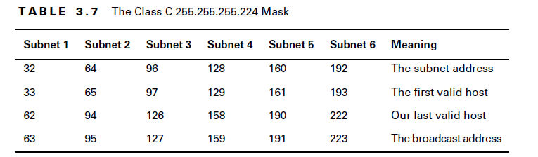

Slide 118
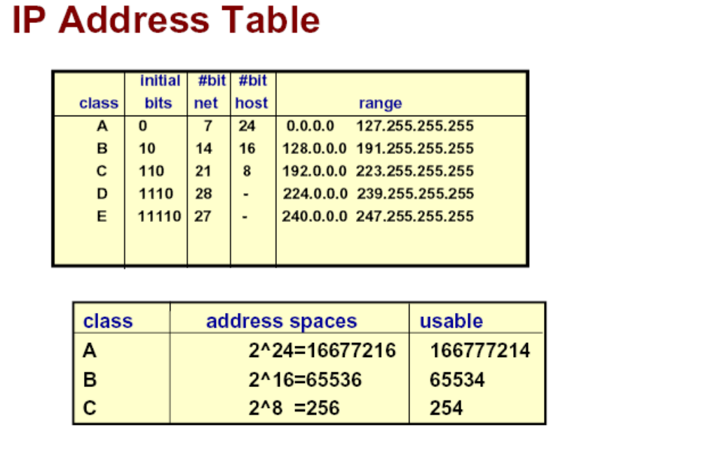
OIT,RMUTT.

Slide 119
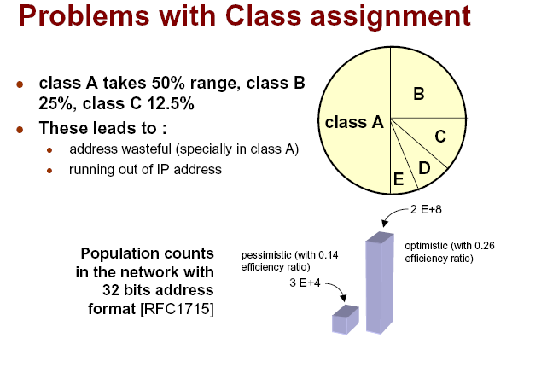
OIT,RMUTT.

Slide 120
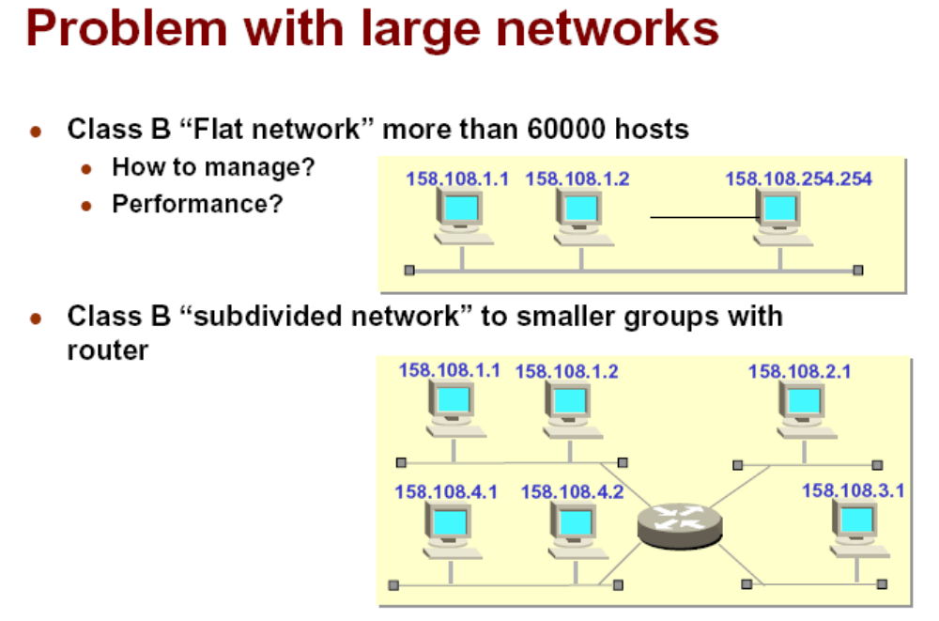
OIT,RMUTT.

Slide 121
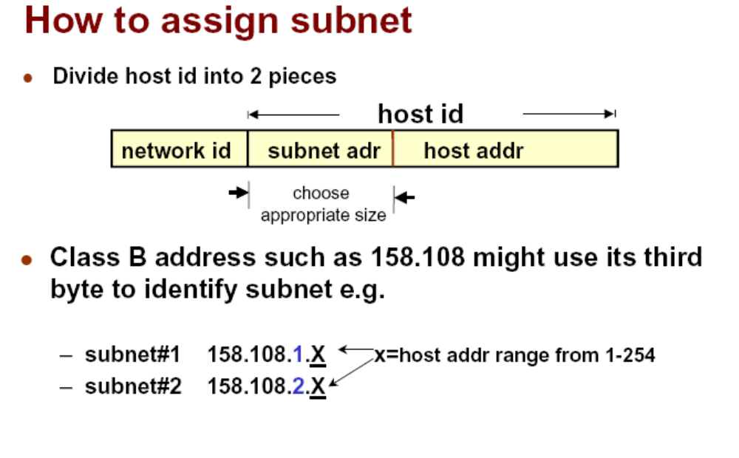
OIT,RMUTT.

Slide 122
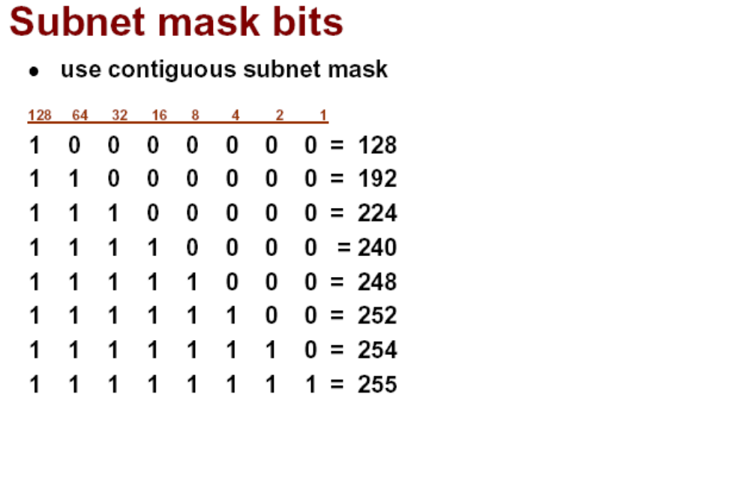
OIT,RMUTT.

Slide 123
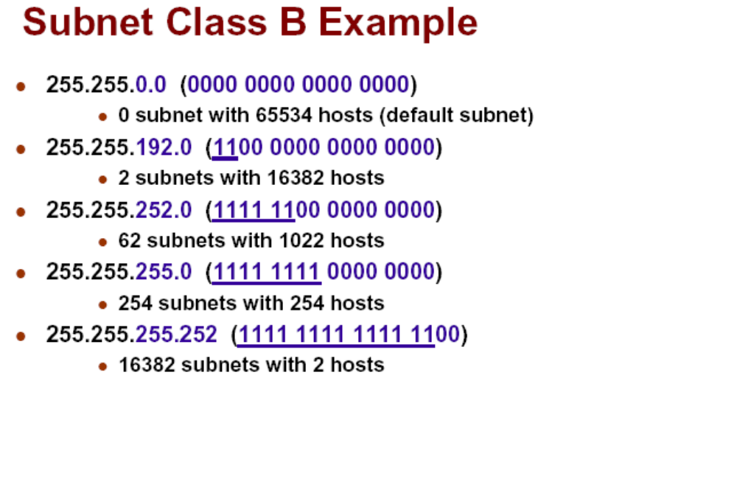
OIT,RMUTT.

Slide 124
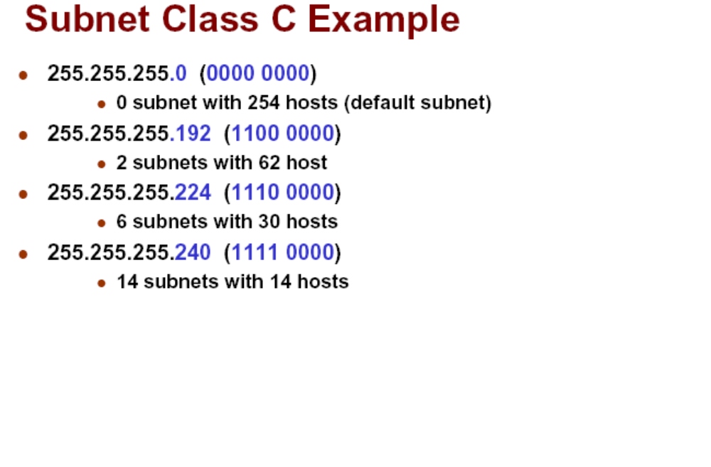
OIT,RMUTT.

Slide 125
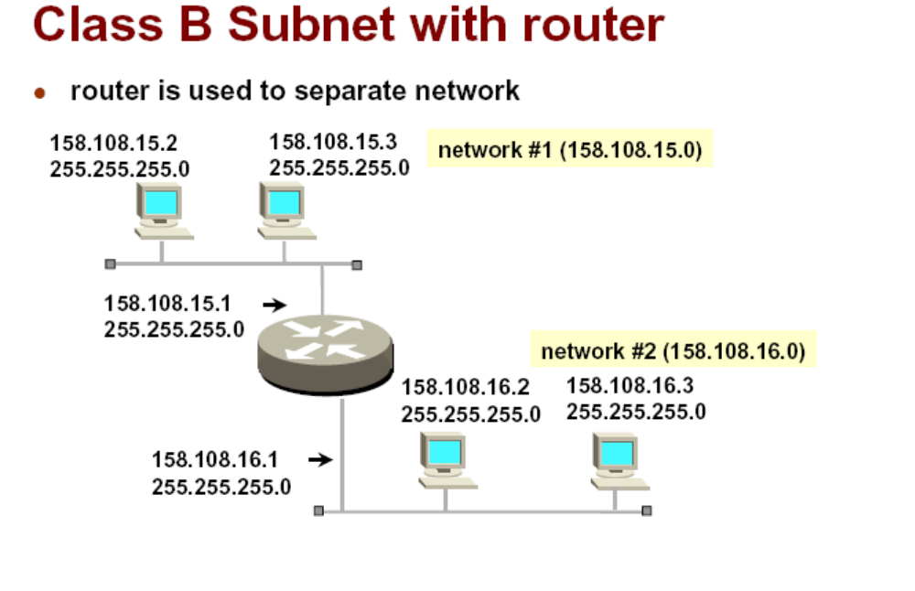
OIT,RMUTT.

Slide 126
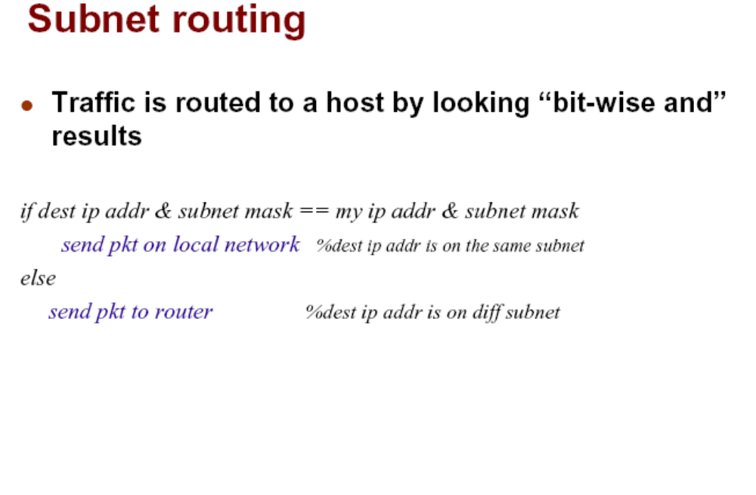
OIT,RMUTT.

Slide 127
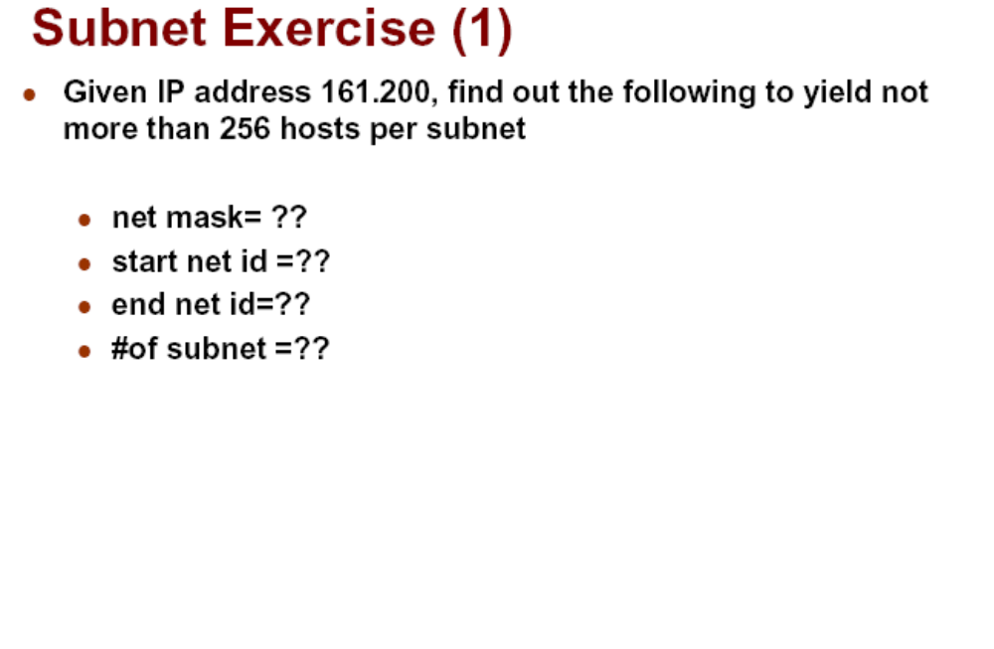
OIT,RMUTT.

Slide 128
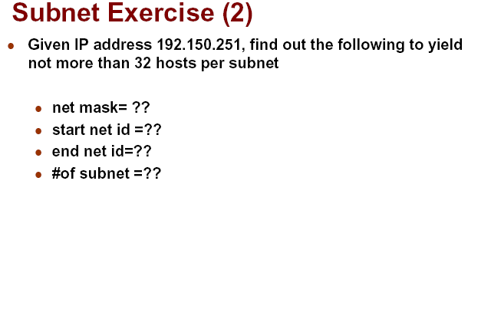
OIT,RMUTT.

Slide 129
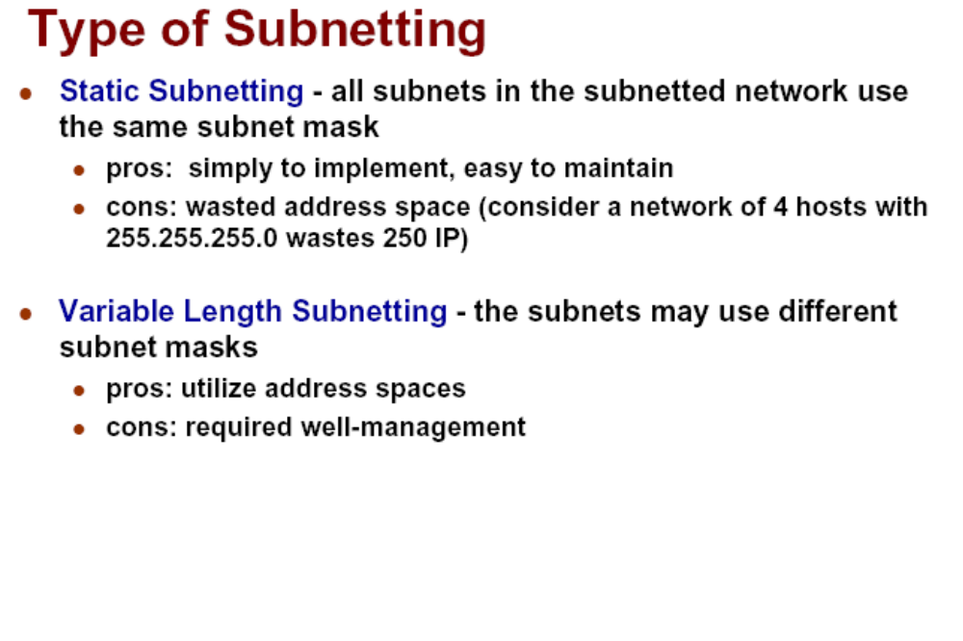
OIT,RMUTT.

Slide 130
CIDR -- Classless InterDomain Routing
192.60.128.0 (11000000.00111100.10000000.00000000) Class C subnet address
192.60.129.0 (11000000.00111100.10000001.00000000) Class C subnet address
192.60.130.0 (11000000.00111100.10000010.00000000) Class C subnet address
192.60.131.0 (11000000.00111100.10000011.00000000) Class C subnet address
--------------------------------------------------------
192.60.128.0 (11000000.00111100.10000000.00000000) Supernetted Subnet address
255.255.252.0 (11111111.11111111.11111100.00000000) Subnet Mask
192.60.131.255 (11000000.00111100.10000011.11111111) Broadcast address
In this example, the subnet 192.60.128.0 includes all the addresses from 192.60.128.0 to 192.60.131.255. As you can see in the binary representation of the subnet mask, the Network portion of the address is 22 bits long, and the host portion is 10 bits long.
OIT,RMUTT.

Slide 131
CIDR(1)
Under CIDR, the subnet mask notation is reduced to a simplified shorthand. Instead of spelling out the bits of the subnet mask, it is simply listed as the number of 1s bits that start the mask. In the above example, instead of writing the address and subnet mask as
192.60.128.0, Subnet Mask 255.255.252.0
the network address would be written simply as:
192.60.128.0/22
OIT,RMUTT.

Slide 132
CIDR(2)
The use of a CIDR notated address is the same as for a Classful address. Classful addresses can easily be written in CIDR notation (Class A = /8, Class B = /16, and Class C = /24)
Reference http://www.sluug.org/resources/cidr.html
OIT,RMUTT.

Slide 133

Variable Length Subnet Masks (VLSMs)
OIT,RMUTT.
© 2004 Cisco Systems, Inc. All rights reserved.
ICND v2.2—3-<number>

Slide 134
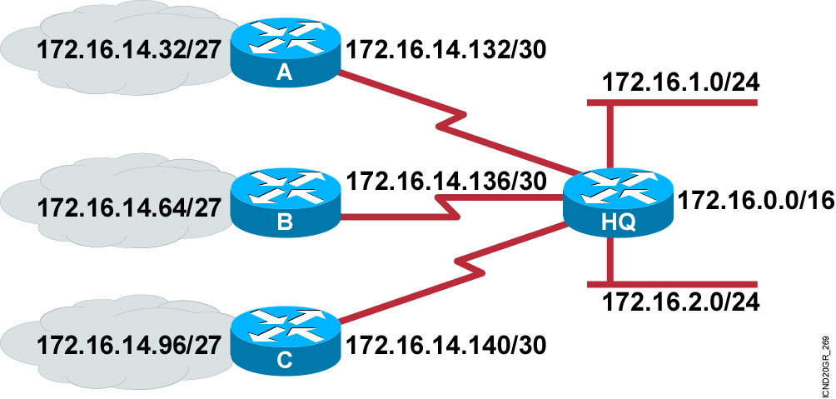
What Is a Variable-Length
Subnet Mask?
  Subnet 172.16.14.0/24 is divided into smaller subnets
    Subnet with one mask (/27)
    Then further subnet one of the unused /27 subnets into multiple /30 subnets
OIT,RMUTT.

Slide 135
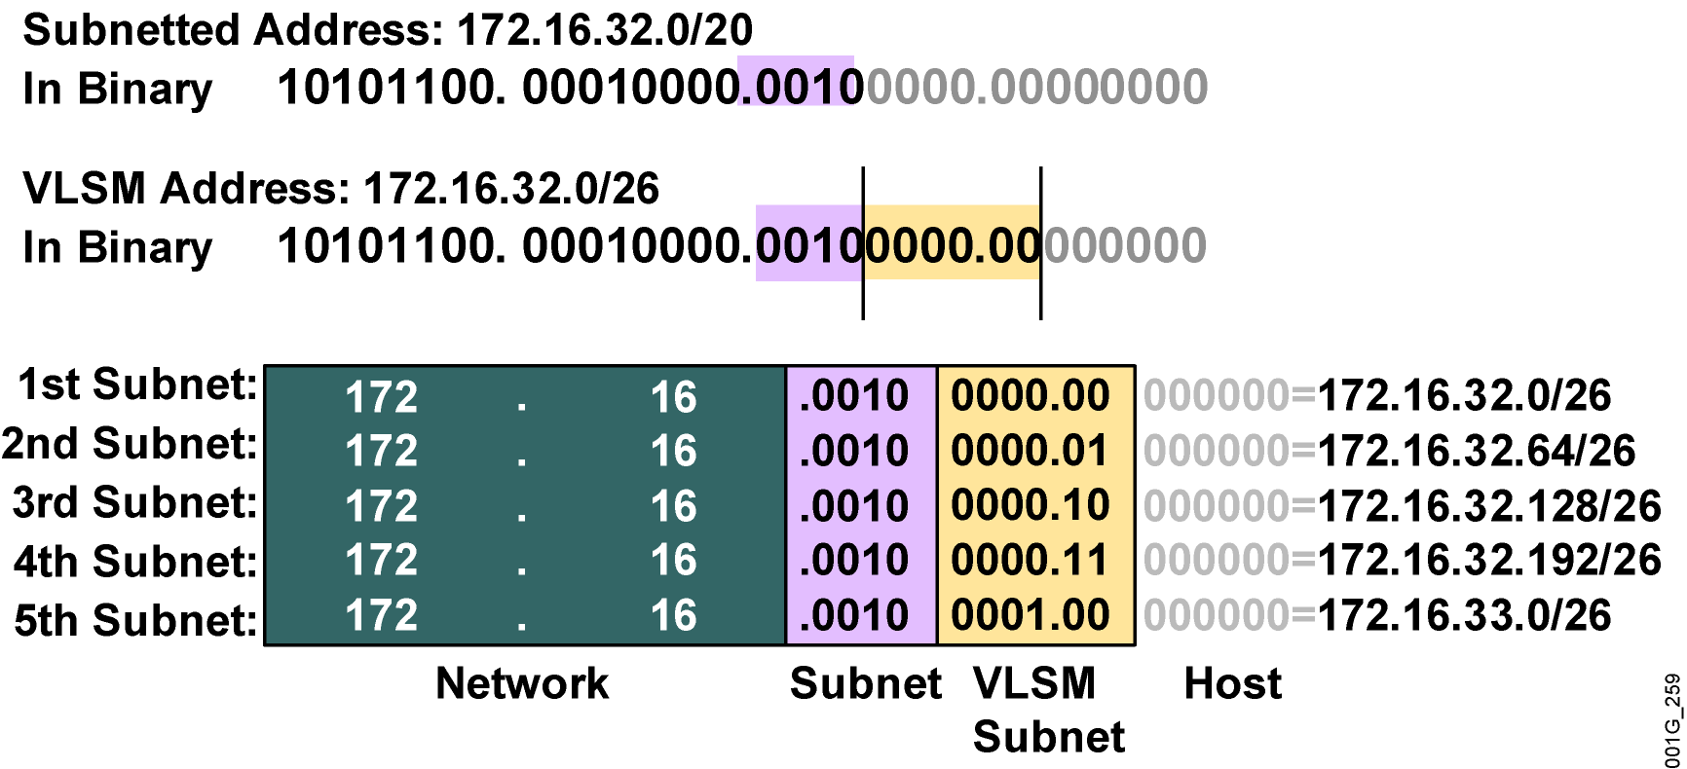
Calculating VLSMs
OIT,RMUTT.

Slide 136
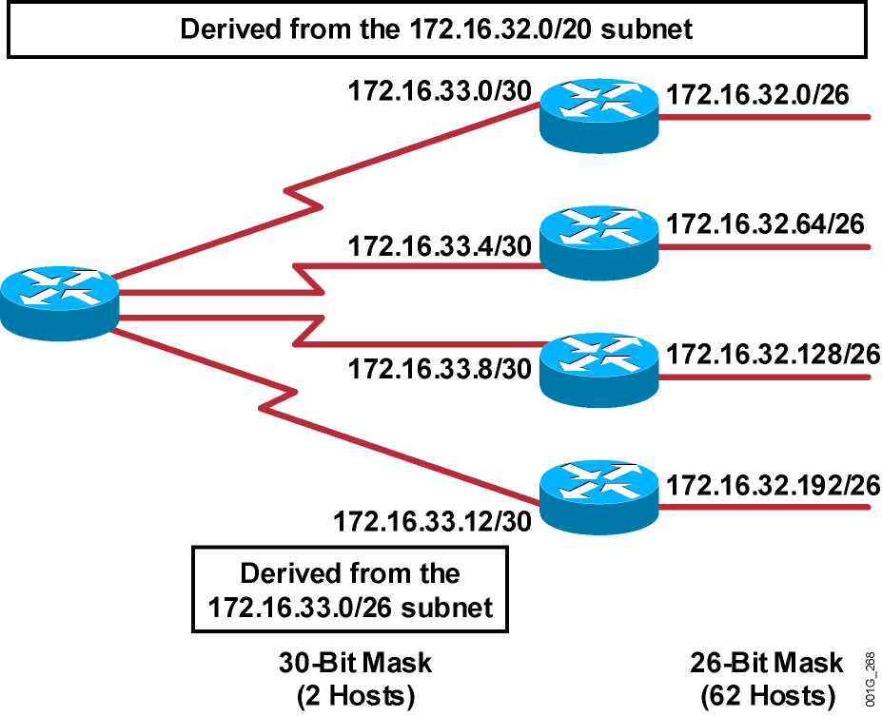
A Working VLSM Example
OIT,RMUTT.

Slide 137
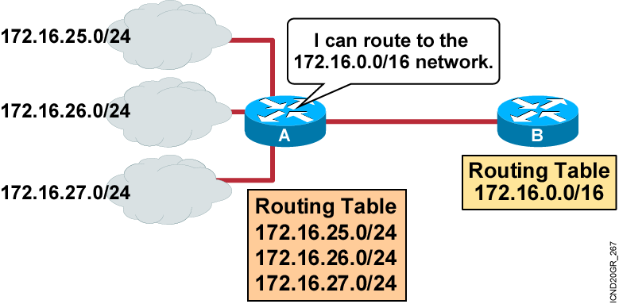
What Is Route Summarization?
  Routing protocols can summarize addresses of several networks into one address.
OIT,RMUTT.

Slide 138
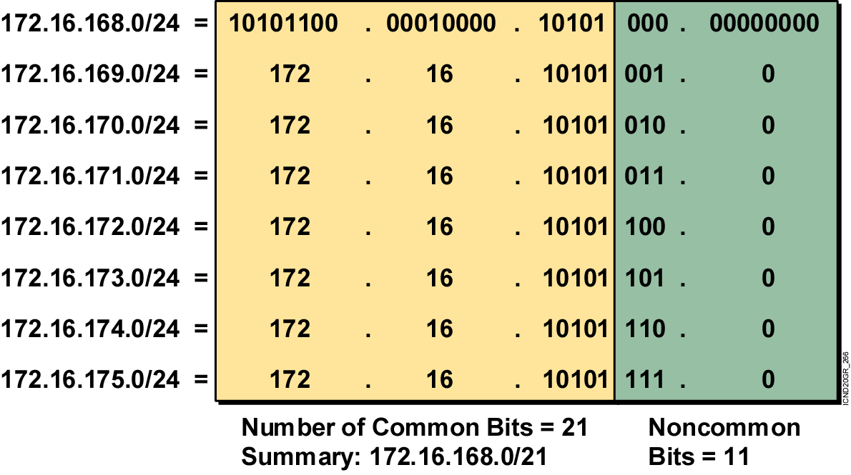
Summarizing Within an Octet
OIT,RMUTT.

Slide 139
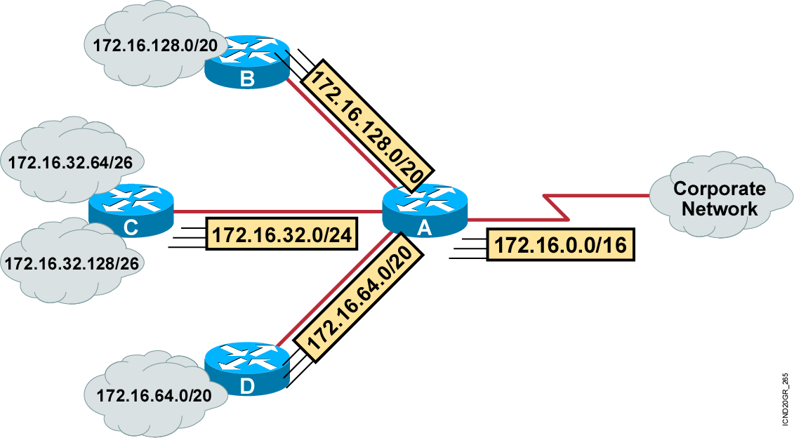
Summarizing Addresses in a VLSM-Designed Network
OIT,RMUTT.

Slide 140
Implementation Considerations
  Multiple IP addresses must have the same highest-order bits.
  Routing decisions are made based on the entire address.
  Routing protocols must carry the prefix (subnet mask) length.
OIT,RMUTT.

Slide 141
Route Summarization Operation in Cisco Routers
192.16.5.33 /32 Host
192.16.5.32 /27 Subnet
192.16.5.0 /24 Network
192.16.0.0 /16 Block of Networks
0.0.0.0 /0 Default
  Supports host-specific routes, blocks of networks, and default routes
  Routers use longest match
OIT,RMUTT.

